Slide 1
Road Extraction from Satellite Images using DeepLabV3+
NAME [USN] : S A SHARAN VERONICA [ENG21CT0035], KAVIYARASU K[ENG22CT1001
TEAM NO - 09
TEAM NAME - ROADNETAI
TOPIC - SATELLITE IMAGERY & AI FOR ROAD NETWORKING ANALYSIS
COURSE : BIG DATA AND DEEP LEARNING
DATE - 15/11/2024

Slide 2

INDEX
PROBLEM STATEMENT
INTRODUCTION
LITERATURE SURVEY
METHODOLOGY

Slide 3
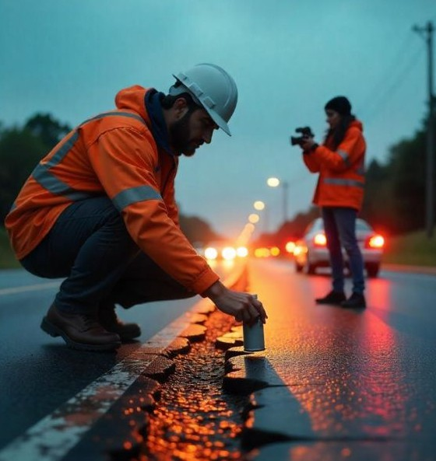
1. PROBLEM STATEMENT
Efficient road network mapping is essential for urban planning, disaster management, and navigation systems.
Traditional methods for road extraction from satellite images are time-intensive, labor-intensive, and prone to inaccuracies.
The challenge is to develop an automated, accurate, and scalable solution for road segmentation and extraction from satellite imagery.

Slide 4
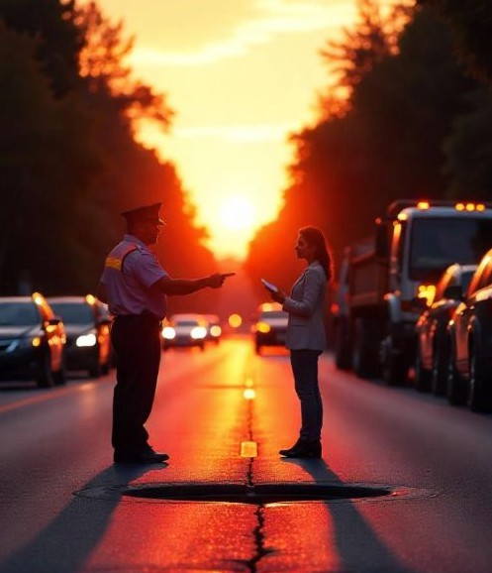
2. INTRODUCTION
This project leverages DeepLabV3+, a state-of-the-art deep learning model, for road segmentation from high-resolution satellite images.
The goal is to produce binary masks that accurately identify road pixels, enabling rapid and precise road network mapping.
By automating the process, this solution supports a wide range of applications, including urban development, navigation systems, and disaster recovery.

Slide 5
3. LITERATURE SURVEY
Paper 1: Road Extraction From Satellite Images Using Attention-Assisted UNet
Summary: Enhances the UNet model with attention mechanisms to better detect and extract roads from satellite images.
Solution: Uses attention modules to focus on important features, improving road detection.
Drawbacks: Needs high computational power and large datasets.
Future Advancements: Develop lighter attention modules for faster processing and real-time use.
Paper 2: Challenging AI for Sustainability: What Ought It Mean?
Summary: Discusses the ethical and environmental impact of using AI for sustainability.
Solution: Offers a framework for responsible AI applications in sustainable development.
Drawbacks: Lacks specific technical solutions or AI models.
Future Advancements: Create energy-efficient AI models to reduce carbon footprint in applications.
real-world

Slide 6
Paper 3: BL-YOLO v8: An Improved Road Defect Detection Model Based on YOLOv8
Summary: Improves YOLO v8 for detecting road defects like potholes and cracks, focusing on small defects.
Solution: Enhances YOLO v8 layers to improve detection accuracy for small defects.
Drawbacks: May struggle with low-resolution images or poor lighting.
Future Advancements: Use data augmentation to improve robustness in diverse conditions.
Paper 4: Dual-Attention-Guided Multiscale Feature Aggregation Network for Remote Sensing Image Change Detection
Summary: Introduces a dual-attention mechanism for better change detection in satellite images.
Solution: Combines dual-attention and multiscale features to capture more details.
Drawbacks: Computationally intensive, not ideal for real-time use with large datasets.
Future Advancements: Optimize for faster processing and use in real-time infrastructure monitoring.

Slide 7
4.METHODOLOGY:
11.Dataset Preparation
Input Data:
High-resolution satellite images serve as input.
Ground truth labeled masks are provided to identify road regions (binary: road vs. non-road).
Preprocessing:
Images are resized to ensure consistency in dimensions.
Data augmentation techniques such as rotation, flipping, scaling, and color jittering are applied to increase dataset variability and prevent overfitting.
Splitting:
The dataset is split into training, validation, and testing sets to ensure robust evaluation.
2. Model Selection
Model Architecture:
DeepLabV3+ is chosen for its superior performance in semantic segmentation tasks.
Encoder-decoder structure:
Encoder: ResNet-50 backbone pre-trained on ImageNet for feature extraction.
Decoder: Upsamples feature maps to generate fine-grained segmentation masks.

Slide 8
3. Training Process
Loss Function:
Dice Loss: Handles class imbalance by focusing on overlap between predicted and actual road regions.
Cross-Entropy Loss: Provides robust multi-class segmentation where necessary.
Optimizer:
Adam optimizer with a learning rate of 0.00008 for efficient weight updates.
Learning Rate Scheduler:
Cosine Annealing Warm Restarts to adjust the learning rate dynamically for better convergence.
Hardware:
Training performed on GPUs (e.g., NVIDIA) to handle computationally intensive tasks.
4.Metrics:
Intersection over Union (IoU): Measures overlap between predicted and ground truth road pixels.
Accuracy: Proportion of correctly classified pixels.
Precision/Recall/F1-Score: Evaluates balance between true positives and false positives/negatives.
Testing:
Evaluate on unseen satellite images to test generalizability.
Visual comparison: Overlay predicted road masks on original images to assess qualitative performance.

Slide 9
THANK YOU

